Slide 1
JavaScript - Team Work
Canvas Monster - project
Developed by
Cookie Monster team
N.Nanev, L.Mitkov and N.Petrov
Date: 19.June 2014

Slide 2
Overview
Create paint-like application in JavaScript under following conditions:
  Using Canvas
  Animations to be created with KanvasJS

Slide 3
Project Features
Drawing basic shapes like:
  Lines
  Rectangles
  Circles
  Brush tool - free ride of the mouse pointer
Erase painted by “rubber” like tool
Change the size and color of the painting tool
Under development functionalities
  Save image
  Load an image

Slide 4
File structure
./index.html – main html file
  ./styles/style.css – css styling of the html
  ./libraries/kinetic-v5.1.0.min.js – KineticJS library
  ./scripts/draw.js – JS code responsible for drawing
  ./scripts/animation.js – animated advertisement

Slide 5
Code structure
window.onload
kinetic.js
draw.js
var definition
Attach - mousedown, mousemove and mouseup event listeners
Functions used:
  ev_canvas()
  changeDrawingTool()
  isToolSelected()
  changeAppearanceOfButton()
  deselectAllTools()
  deselectAllButtons()
  changeColor()
  changeWidth()
  clearCanvas()
  img_update()
animation.js
createLogoAnimation()
  initializeCanvas()
  telerikLogo()
  telericText()
    text()
    point()
  animation()

Slide 6
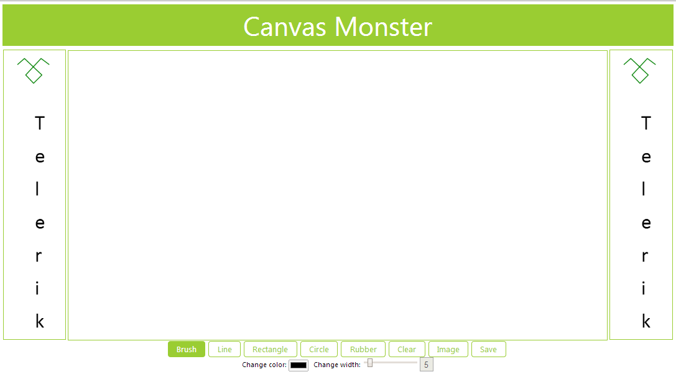
Preview
Painting area
Animated Add
Animated Add
TOOL BOX

Slide 7
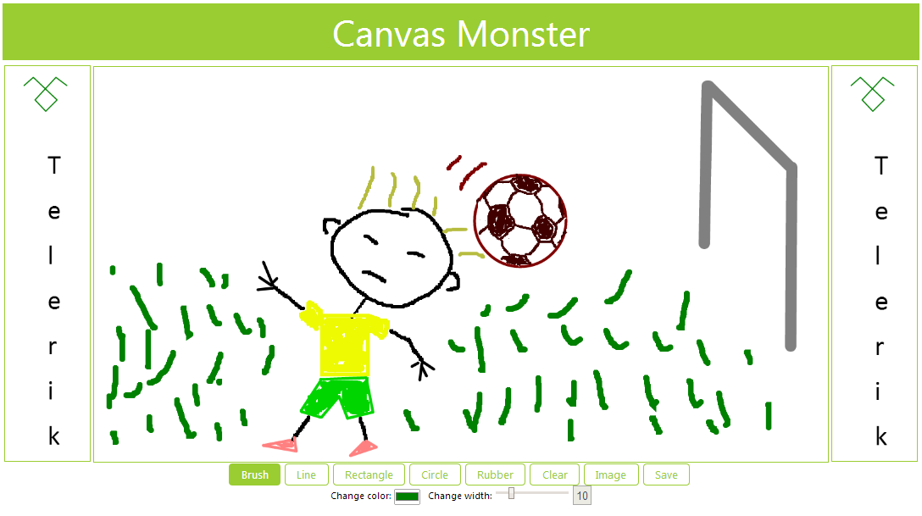
Preview

Slide 8
Thank you for your attention!

